Slide 1
Random Graph

Slide 2



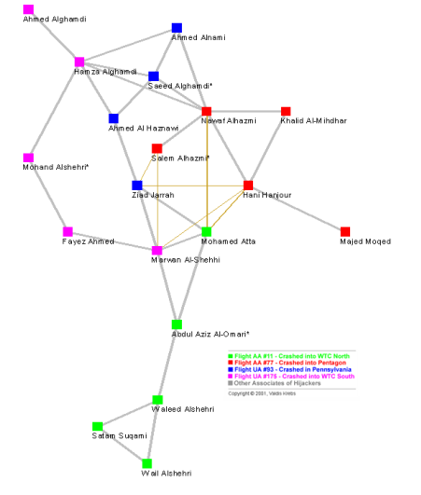
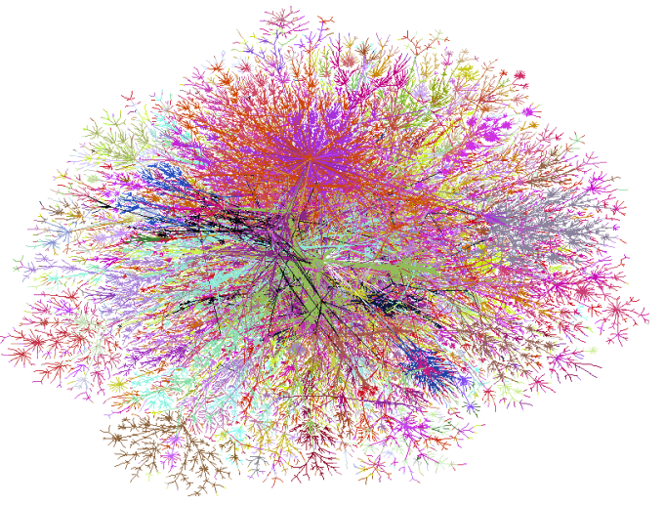
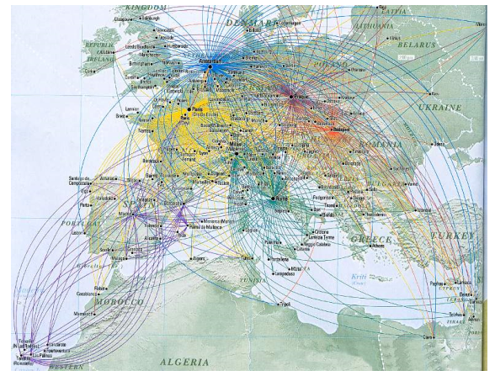
Graphs are Everywhere
Facebook Friendship Network
News Agencies Graph
Bluetooth Graph
Terrorist Network
The Internet
Airline Network

Slide 3
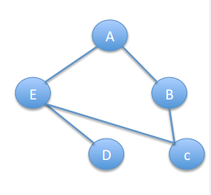
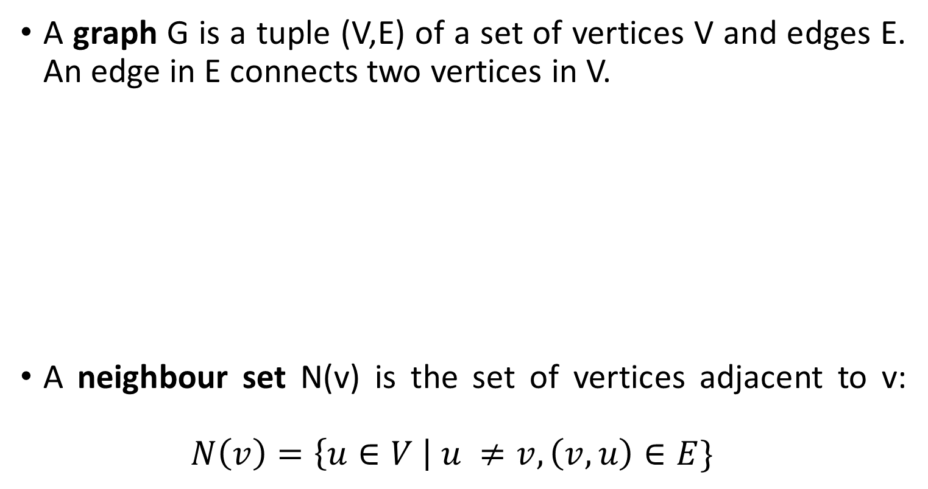
A Network is a Graph
A graph G is a tuple (V,E) of a set of vertices V and edges E. An edge in E connects two vertices in V.
A neighbour set N(v) is the set of vertices adjacent to v: $N\left(v\right)=\left\{u∈V \right| u ≠v, \left(v,u\right)∈E\}$

Slide 4
Node Degree
The node degree is the number of neighbours of a node.
E.g., Degree of A is 2

Slide 5
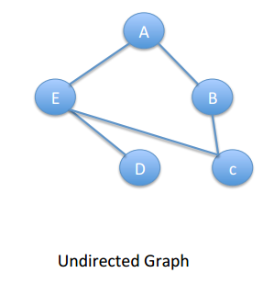
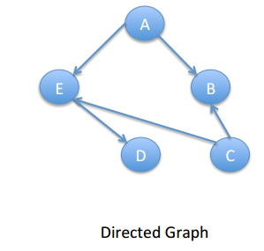
Directed & Undirected Graphs
Example of Undirected Graphs: Facebook
Examples of Directed: Twitter, Email, Phone Calls

Slide 6
Paths and Cycles
A path is a sequence of nodes in which each pair of consecutive nodes is connected by an edge.
If a graph is directed the edge needs to be in the right direction.
E.g. A-E-D is a path in both the graphs
A cycle is a path where the start node is also the end node
E.g. E-A-B-C is a cycle in the undirected graph

Slide 7
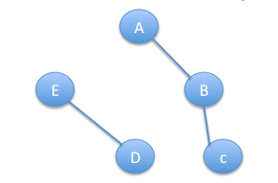
Connectivity
A graph is connected if there is a path between each pair of nodes.
Example of disconnected graph:

Slide 8
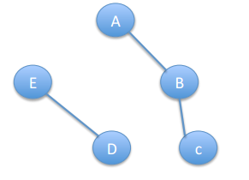
Components
A connected component of a graph is the subset of nodes for which each of them has a path to all others (and the subset is not part of a larger subset with this property).
Connected components: A-B-C and E-D
A giant component is a connected component containing a significant fraction of nodes in the network.
Real networks often have one unique giant component.

Slide 9
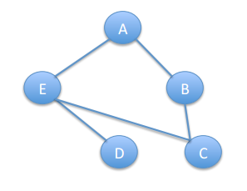
Path Length/Distance
The distance (d) between two nodes in a graph is the length of the shortest path linking the two graphs.
The diameter of the graph is the maximum distance between any pair of its nodes.
To find the diameter of a graph, first find the shortest path between each pair of vertices. The greatest length of any of these paths is the diameter of the graph.
What is the diameter here ?

Slide 10
Probability Distributions

Slide 11
Random Variable
A random variable is a variable that assumes numerical values associated with the random outcomes of an experiment, where one (and only one) numerical value is assigned to each sample point.

Slide 12
Discrete Random Variable
Random variables that can assume a countable number (finite or infinite) of values are called discrete.
Examples
Random Variable
Possible Values
Experiment
Make 100 Sales Calls
# Sales
0, 1, 2, ..., 100
Inspect 70 Radios
# Defective
0, 1, 2, ..., 70
Answer 33 Questions
# Correct
0, 1, 2, ..., 33

Slide 13
Continuous Random Variable
Random variables that can assume values corresponding to any of the points contained in one or more intervals (i.e., values that are infinite and uncountable) are called continuous.
Examples:
Random Variable
Experiment
Possible Values
Weight 100 People
Weight
45.1, 78, ...
Measure Part Life
Hours
900, 875.9, ...
Amount spent on food
$ amount
54.12, 42, ...
Measure Time
Inter-Arrival
0, 1.3, 2.78, ...
Between Arrivals
Time

Slide 14
Probability Distributions for Discrete Random Variables

Slide 15
Discrete Probability Distribution
The probability distribution of a discrete random variable is a graph, table, or formula that specifies the probability associated with each possible value the random variable can assume.

Slide 16
Requirements for the Probability Distribution of a Discrete Random Variable x
p(x) ≥ 0 for all values of x
Σ p(x) = 1
where the summation of p(x) is over all possible values of x.

Slide 17
Discrete Probability Distribution Example
Experiment: Toss 2 coins. Count number of tails.
Probability Distribution
Values, x Probabilities, p(x)
0 1/4 = .25
1 2/4 = .50
2 1/4 = .25

Slide 18
Visualizing Discrete Probability Distributions
Listing
Table
{ (0, .25), (1, .50), (2, .25) }
f(x)
p(x)
# Tails
Count
0
1
.25
1
2
.50
Graph
2
1
.25
p(x)
.50
.25
Formula
.00
x
n
!
p
(
x
)
=
p^{x}(1 – p)^{n – x}
0
1
2
x!(n – x)!

Slide 19
Summary Measures
Expected Value (Mean of probability distribution)
Weighted average of all possible values
μ = E(x) = Σx p(x)
Variance
Weighted average of squared deviation about mean
σ² = E[(x − μ)²] = Σ (x − μ)² p(x)
3. Standard Deviation
●
Notes:
population notation is used since all values are specified.

Slide 20
Summary Measures Calculation Table
x
p(x)
x p(x)
x – μ
(x – μ)²
(x – μ)²p(x)
Total
Σx p(x)
Σ(x − μ)² p(x)

Slide 21
Expected Value & Variance Solution
x
p(x)
x p(x)
x – μ
(x – μ) ²
(x – μ) ²p(x)
0
.25
0
–1.00
1.00
.25
1
.50
.50
0
0
0
2
.25
.50
1.00
1.00
.25
μ
= 1.0
σ² = .50
σ = .71

Slide 22
The Binomial Distribution

Slide 23
Binomial Distribution
Number of ‘successes’ in a sample of n observations (trials)
Number of reds in 15 spins of roulette wheel
Number of defective items in a batch of 5 items
Number correct on a 33 question exam
Number of customers who purchase out of 100 customers who enter store (each customer is equally likely to purchase)

Slide 24
Binomial Probability
Characteristics of a Binomial Experiment
The experiment consists of n identical trials.
There are only two possible outcomes on each trial. We will denote one outcome by S (for success) and the other by F (for failure).
The probability of S remains the same from trial to trial. This probability is denoted by p, and the probability of F is denoted by q. Note that q = 1 – p.
The trials are independent.
The binomial random variable x is the number of S’s in n trials.

Slide 25
Binomial Probability Distribution
A Binomial Random Variable
n identical trials
Two outcomes: Success or Failure
P(S) = p; P(F) = q = 1 – p
Trials are independent
x is the number of Successes in n trials

Slide 26
Binomial Probability Distribution
Flip a coin 3 times
Outcomes are Heads or Tails
P(H) = .5; P(F) = 1-.5 = .5
A head on flip i doesn’t change P(H) of flip i + 1
A Binomial Random Variable
n identical trials
Two outcomes: Success or Failure
P(S) = p; P(F) = q = 1 – p
Trials are independent
x is the number of S’s in n trials

Slide 27
Binomial Probability Distribution
The Binomial Probability Distribution
p = P(S) on a single trial
q = 1 – p
n = number of trials
x = number of successes

Slide 28
Binomial Probability Distribution
The Binomial Probability Distribution
The probability of getting the required number of successes
The probability of getting the required number of failures
The number of ways of getting the desired results

Slide 29
Binomial Probability Distribution
Say 40% of the class is female.
What is the probability that 6 of the first 10 students walking in will be female?

Slide 30
Binomial Probability Distribution Example
Experiment: Toss 1 coin 5 times in a row. Note number of tails. What’s the probability of 3 tails?

Slide 31
Binomial Distribution Thinking Challenge
You’re a telemarketer selling service contracts for Jio. You’ve sold 20 in your last 100 calls (p = .20). If you call 12 people tonight, what’s the probability of
No sales?
Exactly 2 sales?
At most 2 sales?
At least 2 sales?

Slide 32
Binomial Distribution Solution
n = 12, p = .20
p(0) = .0687
p(2) = .2835
p(at most 2) = p(0) + p(1) + p(2) = .0687 + .2062 + .2835 = .5584
p(at least 2) = p(2) + p(3)...+ p(12) = 1 – [p(0) + p(1)] = 1 – .0687 – .2062 = .7251

Slide 33
Poisson Distribution
Number of events that occur in an interval
events per unit
Time, Length, Area, Space
Examples
Number of customers arriving in 20 minutes
Number of strikes per year in the India.
Number of defects per lot (group) of DVD’s
Notes:
Other Examples:
Number of machines that break down in a day
Number of units sold in a week
Number of people arriving at a bank teller per hour
Number of telephone calls to customer support per hour

Slide 34
Characteristics of a Poisson Random Variable
Consists of counting number of times an event occurs during a given unit of time or in a given area or volume (any unit of measurement).
The probability that an event occurs in a given unit of time, area, or volume is the same for all units.
The number of events that occur in one unit of time, area, or volume is independent of the number that occur in any other mutually exclusive unit.
The mean number of events in each unit is denoted by λ.

Slide 35
Poisson Probability Distribution Function
x
–
λ
e
λ
p
(
x
)
=
(x = 0, 1, 2, 3, . . .)
x
!
μ = λ
σ² = λ
p(x) = Probability of x given λ
λ = Mean (expected) number of events in unit
e = 2.71828 . . . (base of natural logarithm)
x = Number of events per unit

Slide 36
Poisson Distribution Example
Customers arrive at a rate of 72 per hour. What is the probability of 4 customers arriving in 3 minutes?
© 1995 Corel Corp.

Slide 37
Poisson Distribution Solution
72 Per Hr. = 1.2 Per Min. = 3.6 Per 3 Min. Interval

Slide 38
Probability Distributions for Continuous Random Variables

Slide 39
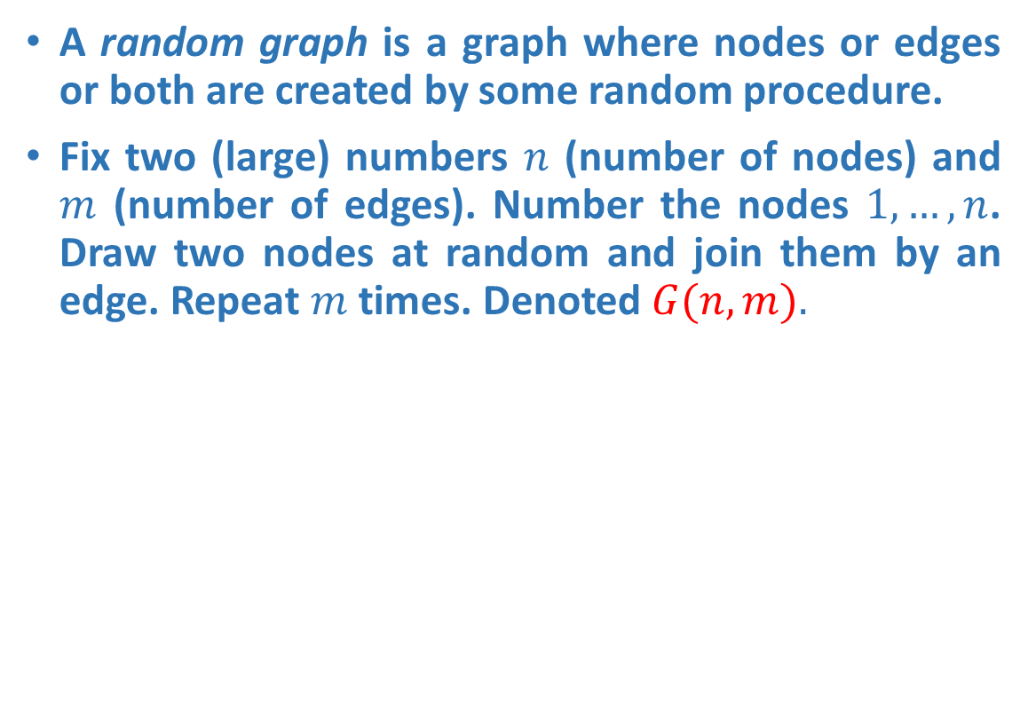
Random Graphs
A random graph is a graph where nodes or edges or both are created by some random procedure.
Fix two (large) numbers $n$ (number of nodes) and $m$ (number of edges). Number the nodes $1, …,n$. Draw two nodes at random and join them by an edge. Repeat $m$ times. Denoted $G(n,m).$

Slide 40
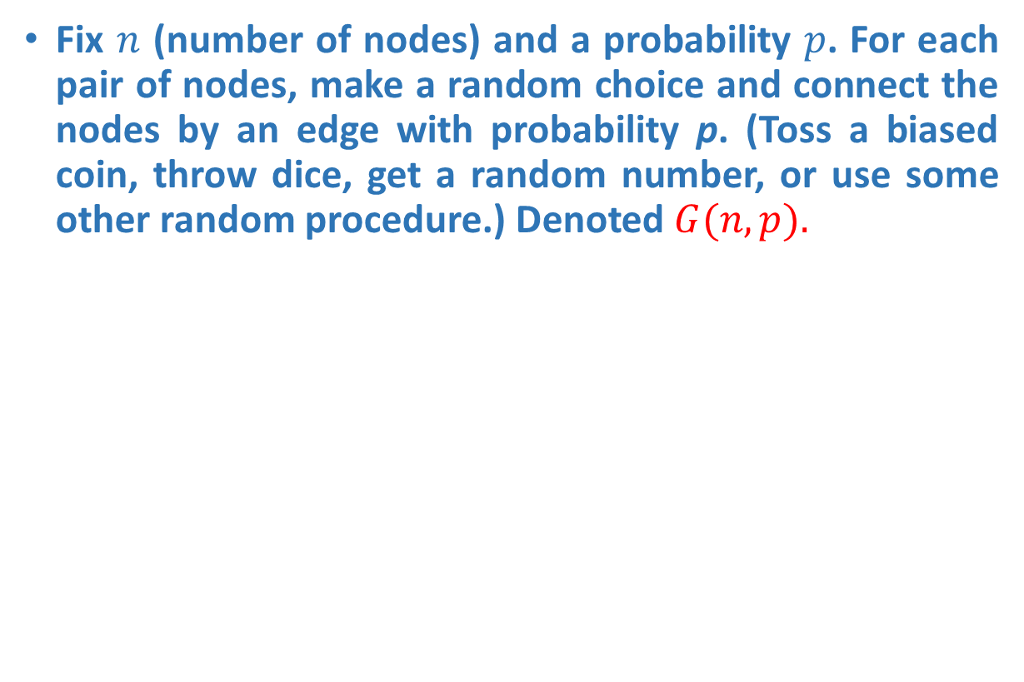
Erdos-Renyi Random Graph
Fix $n$ (number of nodes) and a probability $p$. For each pair of nodes, make a random choice and connect the nodes by an edge with probability p. (Toss a biased coin, throw dice, get a random number, or use some other random procedure.) Denoted $G(n,p).$

Slide 41
Application of Random Graph
Graphs are used to describe possible infection routes for an infectious disease. Typically, the graph is not known in detail (and even if it is, it will be different tomorrow), and a suitable random graph may be used as a model.
Graphs and random graphs are used to describe the structure of the Internet. (In several different ways) Again a suitable random model may be useful.
Graphs are used to describe a lot of things, for example references between scientific papers, collaborations (joint publications) between scientists, interactions between proteins in yeast, telephone calls in a given day, . . . A suitable random model may be useful.

Slide 42
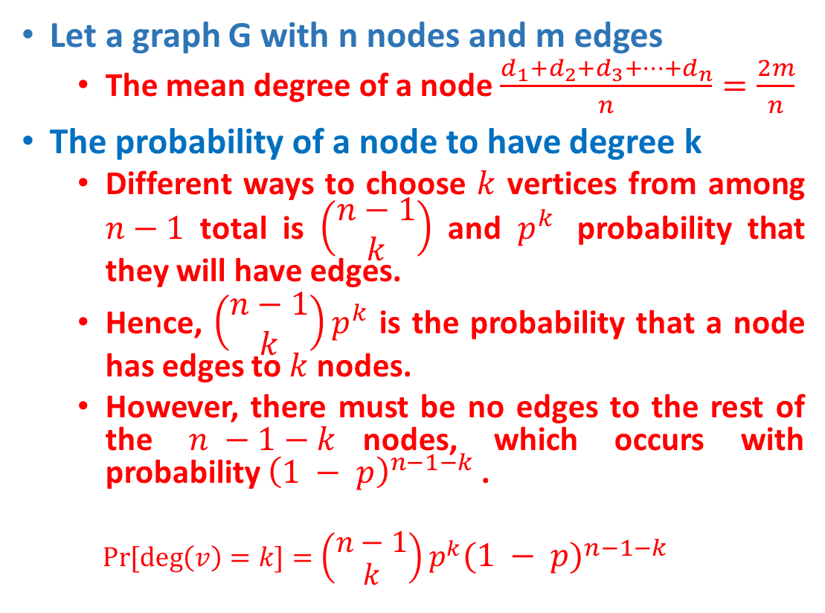
Mean degree and degree distribution
Let a graph G with n nodes and m edges
The mean degree of a node $\frac{d_{1}+d_{2}+d_{3}+…+d_{n}}{n}=\frac{2m}{n}$
The probability of a node to have degree k
Different ways to choose $k$ vertices from among $n−1$ total is $\left(\begin{matrix}n−1 \\ k\end{matrix}\right)$ and $p^{k}$ probability that they will have edges.
Hence, $\left(\begin{matrix}n−1 \\ k\end{matrix}\right)p^{k}$ is the probability that a node has edges to $k$ nodes.
However, there must be no edges to the rest of the $n −1−k$nodes, which occurs with probability ${\left(1 − p\right)}^{n−1−k}$.
$$\operatorname{Pr}{[\deg\left(v\right)=k]}=\left(\begin{matrix}n−1 \\ k\end{matrix}\right)p^{k}{\left(1 − p\right)}^{n−1−k}$$
Edges exist to k nodes
No edges to n-1- k nodes

Slide 43
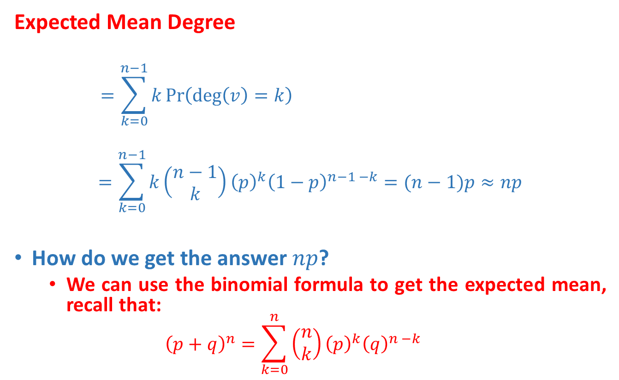
Mean degree and degree distribution
Expected Mean Degree
$$=\sum_{k=0}^{n−1}{k\operatorname{Pr}\left(\deg\left(v\right)=k\right) }$$
$$=\sum_{k=0}^{n−1}{k\left(\begin{matrix}n−1 \\ k\end{matrix}\right){\left(p\right)}^{k}{\left(1−p\right)}^{n−1 −k}}=(n−1)p≈np$$
How do we get the answer $np$?
We can use the binomial formula to get the expected mean, recall that:
$${\left(p+q\right)}^{n}=\sum_{k=0}^{n}{\left(\begin{matrix}n \\ k\end{matrix}\right){\left(p\right)}^{k}{\left(q\right)}^{n −k}}$$

Slide 44
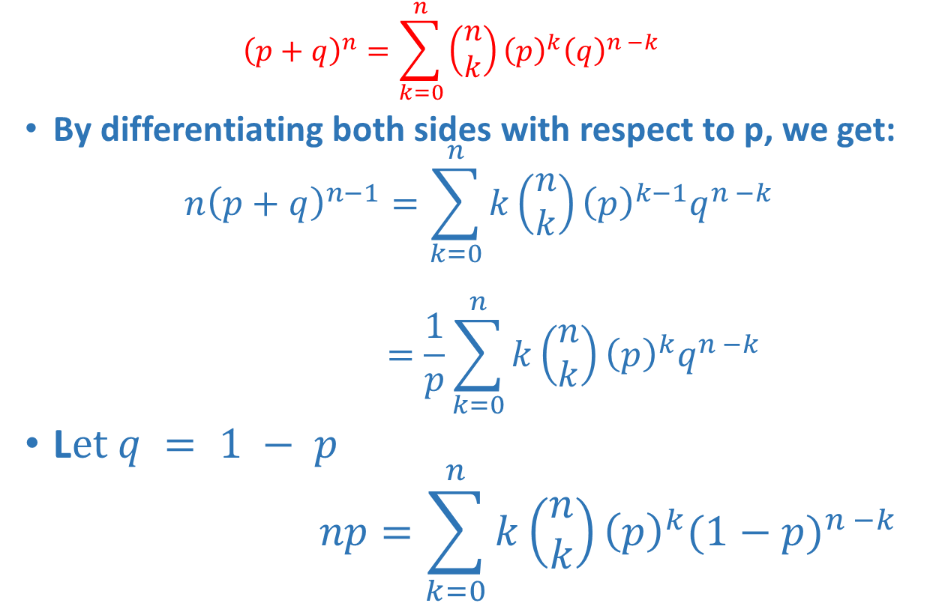
Mean degree and degree distribution
$${\left(p+q\right)}^{n}=\sum_{k=0}^{n}{\left(\begin{matrix}n \\ k\end{matrix}\right){\left(p\right)}^{k}{\left(q\right)}^{n −k}}$$
By differentiating both sides with respect to p, we get:
$$n{\left(p+q\right)}^{n−1}=\sum_{k=0}^{n}{k\left(\begin{matrix}n \\ k\end{matrix}\right){\left(p\right)}^{k−1}q^{n −k}}$$
$$=\frac{1}{p}\sum_{k=0}^{n}{k\left(\begin{matrix}n \\ k\end{matrix}\right){\left(p\right)}^{k}q^{n −k}}$$
L$et q = 1 − p$
$$np=\sum_{k=0}^{n}{k\left(\begin{matrix}n \\ k\end{matrix}\right){\left(p\right)}^{k}{(1−p)}^{n −k}}$$

Slide 45
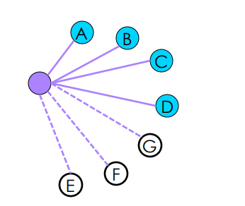
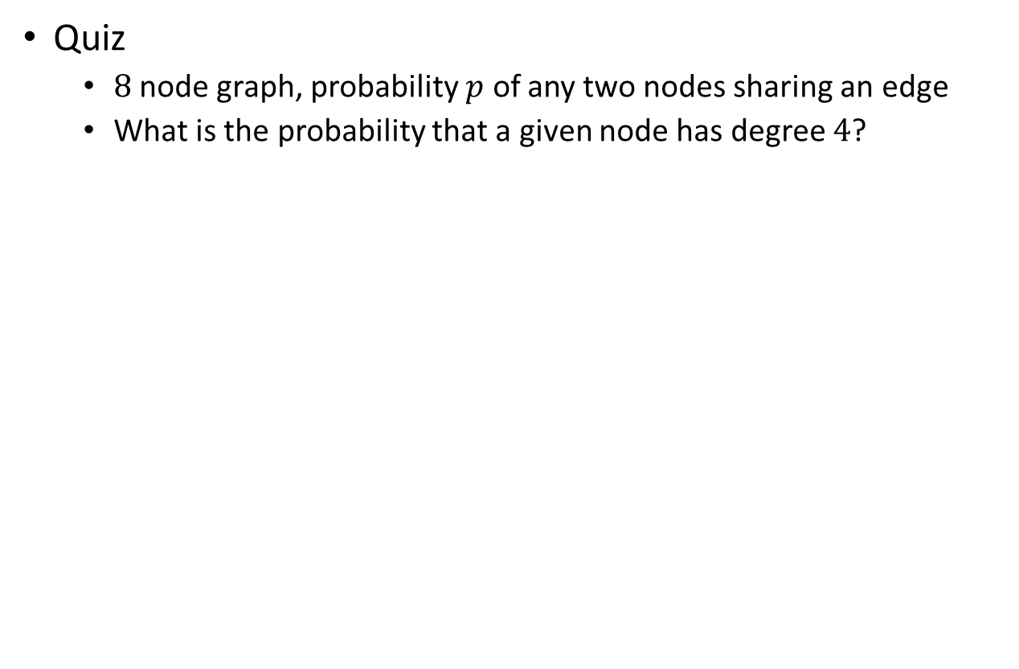
Mean degree and degree distribution
Quiz
$8$ node graph, probability $p$ of any two nodes sharing an edge
What is the probability that a given node has degree $4$?

Slide 46
Mean degree and degree distribution
Quiz
What is the average degree of a graph with 10 nodes and probability p = 1/3 of an edge existing between any two nodes?

Slide 47
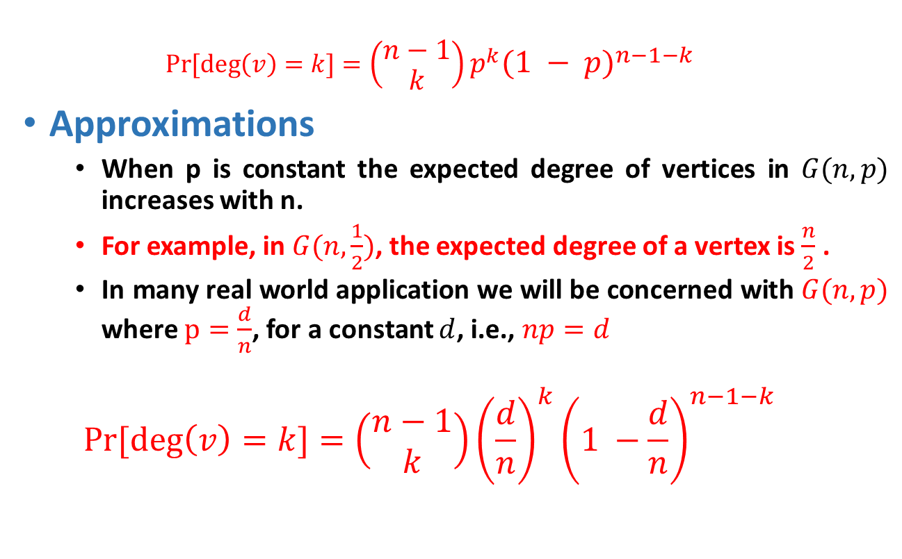
Degree distribution
$$\operatorname{Pr}{[\deg\left(v\right)=k]}=\left(\begin{matrix}n−1 \\ k\end{matrix}\right)p^{k}{\left(1 − p\right)}^{n−1−k}$$
Approximations
When p is constant the expected degree of vertices in $G(n,p)$ increases with n.
For example, in $G(n,\frac{1}{2})$, the expected degree of a vertex is $\frac{n}{2}$ .
In many real world application we will be concerned with $G(n,p)$ where $p=\frac{d}{n}$, for a constant $d$, i.e., $np=d$
$$\operatorname{Pr}{[\deg\left(v\right)=k]}=\left(\begin{matrix}n−1 \\ k\end{matrix}\right){\left(\frac{d}{n}\right)}^{k}{\left(1 −\frac{d}{n}\right)}^{n−1−k}$$

Slide 48
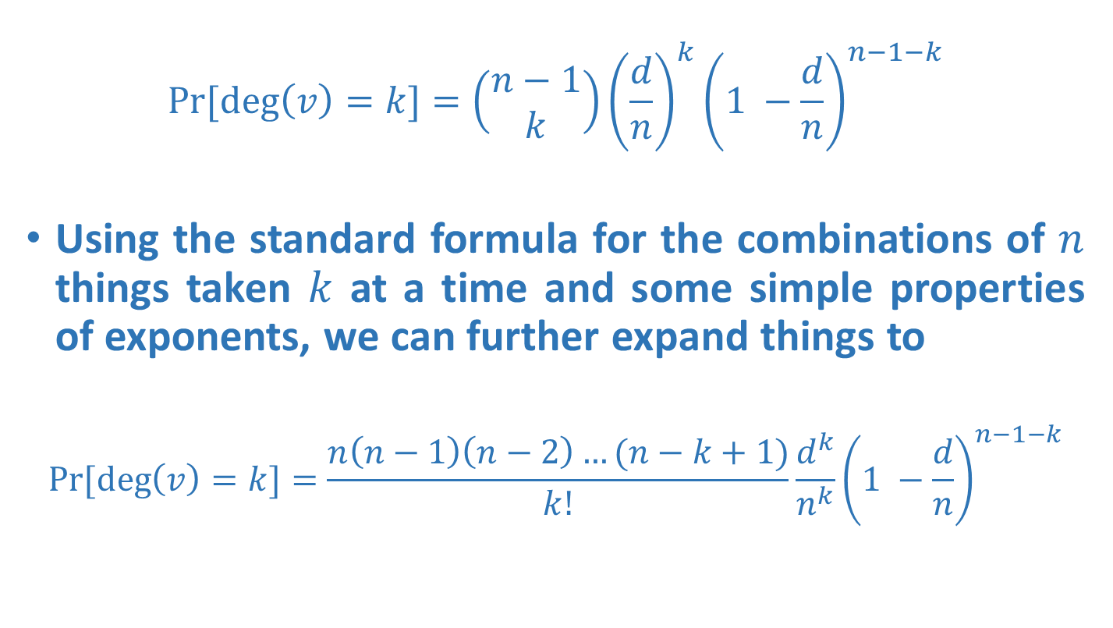
Degree distribution
$$\operatorname{Pr}{[\deg\left(v\right)=k]}=\left(\begin{matrix}n−1 \\ k\end{matrix}\right){\left(\frac{d}{n}\right)}^{k}{\left(1 −\frac{d}{n}\right)}^{n−1−k}$$
Using the standard formula for the combinations of $n$ things taken $k$ at a time and some simple properties of exponents, we can further expand things to
$$\operatorname{Pr}{[\deg\left(v\right)=k]}=\frac{n\left(n−1\right)\left(n−2\right)…(n−k+1)}{k!}\frac{d^{k}}{n^{k}}{\left(1 −\frac{d}{n}\right)}^{n−1−k}$$

Slide 49
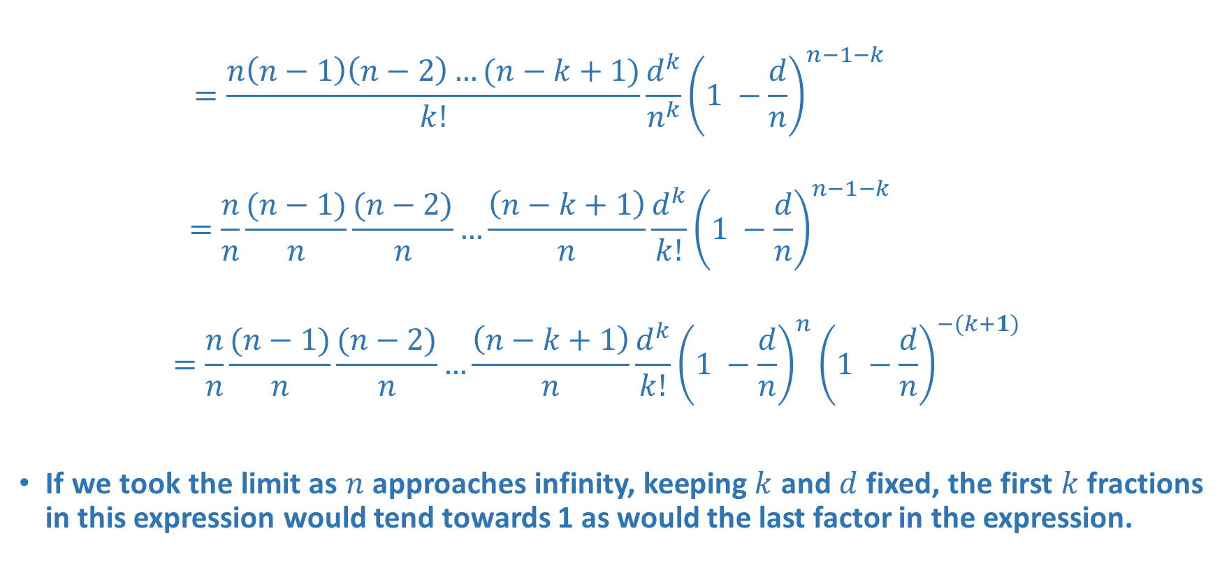
Degree distribution
$$=\frac{n\left(n−1\right)\left(n−2\right)…(n−k+1)}{k!}\frac{d^{k}}{n^{k}}{\left(1 −\frac{d}{n}\right)}^{n−1−k}$$
$$=\frac{n}{n}\frac{(n−1)}{n}\frac{(n−2)}{n}…\frac{\left(n−k+1\right)}{n}\frac{d^{k}}{k!}{\left(1 −\frac{d}{n}\right)}^{n−1−k}$$
$$=\frac{n}{n}\frac{(n−1)}{n}\frac{(n−2)}{n}…\frac{\left(n−k+1\right)}{n}\frac{d^{k}}{k!}{\left(1 −\frac{d}{n}\right)}^{n}{\left(1 −\frac{d}{n}\right)}^{−(k+1)}$$
If we took the limit as $n$ approaches infinity, keeping $k$ and $d$ fixed, the first $k$fractions in this expression would tend towards 1 as would the last factor in the expression.

Slide 50
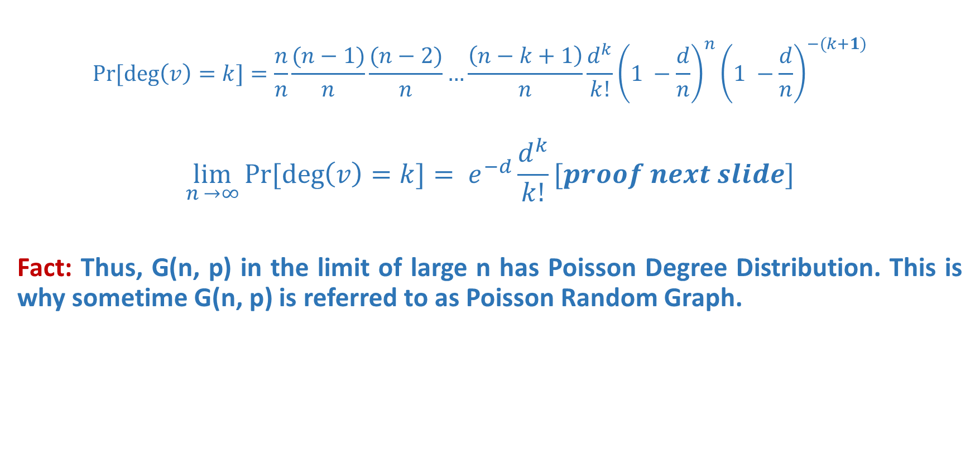
Degree distribution
$$\operatorname{Pr}{[\deg\left(v\right)=k]}=\frac{n}{n}\frac{(n−1)}{n}\frac{(n−2)}{n}…\frac{\left(n−k+1\right)}{n}\frac{d^{k}}{k!}{\left(1 −\frac{d}{n}\right)}^{n}{\left(1 −\frac{d}{n}\right)}^{−(k+1)}$$
$$\lim_{n →∞}{\operatorname{Pr}{[\deg\left(v\right)=k]}}= e^{−d}\frac{d^{k}}{k!}[proof next slide]$$
Fact: Thus, G(n, p) in the limit of large n has Poisson Degree Distribution. This is why sometime G(n, p) is referred to as Poisson Random Graph.

Slide 51
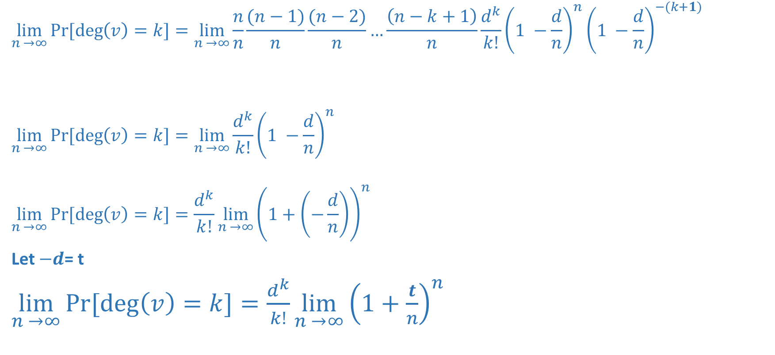
Degree distribution
$$\lim_{n →∞}{\operatorname{Pr}{[\deg\left(v\right)=k]}}=\lim_{n →∞}\frac{n}{n}\frac{(n−1)}{n}\frac{(n−2)}{n}…\frac{\left(n−k+1\right)}{n}\frac{d^{k}}{k!}{\left(1 −\frac{d}{n}\right)}^{n}{\left(1 −\frac{d}{n}\right)}^{−(k+1)}$$
$$\lim_{n →∞}{\operatorname{Pr}{[\deg\left(v\right)=k]}}=\lim_{n →∞}\frac{d^{k}}{k!}{\left(1 −\frac{d}{n}\right)}^{n}$$
$$\lim_{n →∞}{\operatorname{Pr}{[\deg\left(v\right)=k]}}=\frac{d^{k}}{k!}\lim_{n →∞}{\left(1+\left(−\frac{d}{n}\right)\right)}^{n}$$
Let $−d$= t
$\lim_{n →∞}{\operatorname{Pr}{[\deg\left(v\right)=k]}}=\frac{d^{k}}{k!}\lim_{n →∞}{\left(1+\frac{t}{n}\right)}^{n}$
1
1
1
1
1

Slide 52
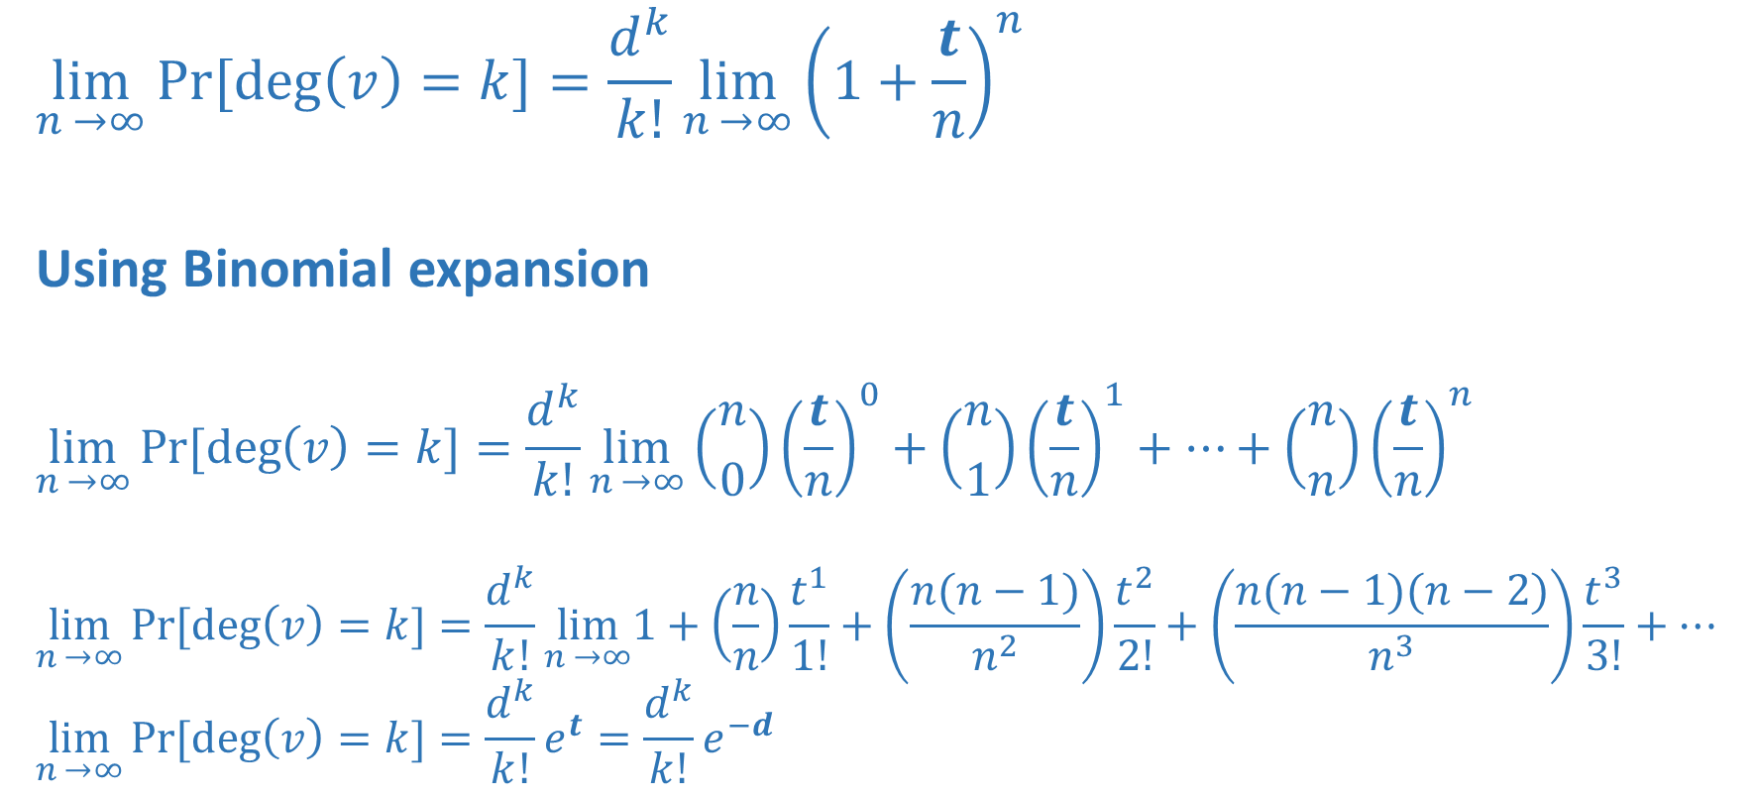
$$\lim_{n →∞}{\operatorname{Pr}{[\deg\left(v\right)=k]}}=\frac{d^{k}}{k!}\lim_{n →∞}{\left(1+\frac{t}{n}\right)}^{n}$$
Using Binomial expansion
$$\lim_{n →∞}{\operatorname{Pr}{[\deg\left(v\right)=k]}}=\frac{d^{k}}{k!}\lim_{n →∞}\left({n \atop 0}\right){\left(\frac{t}{n}\right)}^{0}+\left({n \atop 1}\right){\left(\frac{t}{n}\right)}^{1}+…+\left({n \atop n}\right){\left(\frac{t}{n}\right)}^{n}$$
$$\lim_{n →∞}{\operatorname{Pr}{[\deg\left(v\right)=k]}}=\frac{d^{k}}{k!}\lim_{n →∞}1+\left(\frac{n}{n}\right)\frac{t^{1}}{1!}+\left(\frac{n(n−1)}{n^{2}}\right)\frac{t^{2}}{2!}+\left(\frac{n(n−1)(n−2)}{n^{3}}\right)\frac{t^{3}}{3!}+…$$
$$\lim_{n →∞}{\operatorname{Pr}{[\deg\left(v\right)=k]}}=\frac{d^{k}}{k!}e^{t}=\frac{d^{k}}{k!}e^{−d}$$

Slide 53
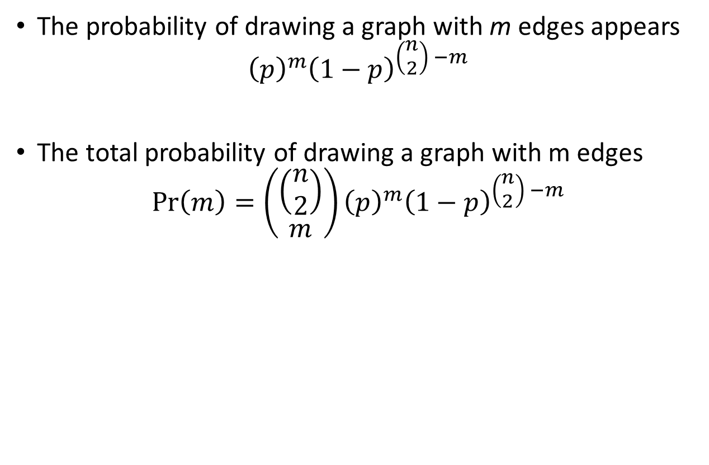
Mean degree and degree distribution
The probability of drawing a graph with m edges appears
$${\left(p\right)}^{m}{\left(1−p\right)}^{\left(\begin{matrix}n \\ 2\end{matrix}\right) −m}$$
The total probability of drawing a graph with m edges
$$\operatorname{Pr}\left(m\right)=\left(\begin{matrix}\left(\begin{matrix}n \\ 2\end{matrix}\right) \\ m\end{matrix}\right){\left(p\right)}^{m}{\left(1−p\right)}^{\left(\begin{matrix}n \\ 2\end{matrix}\right) −m}$$

Slide 54
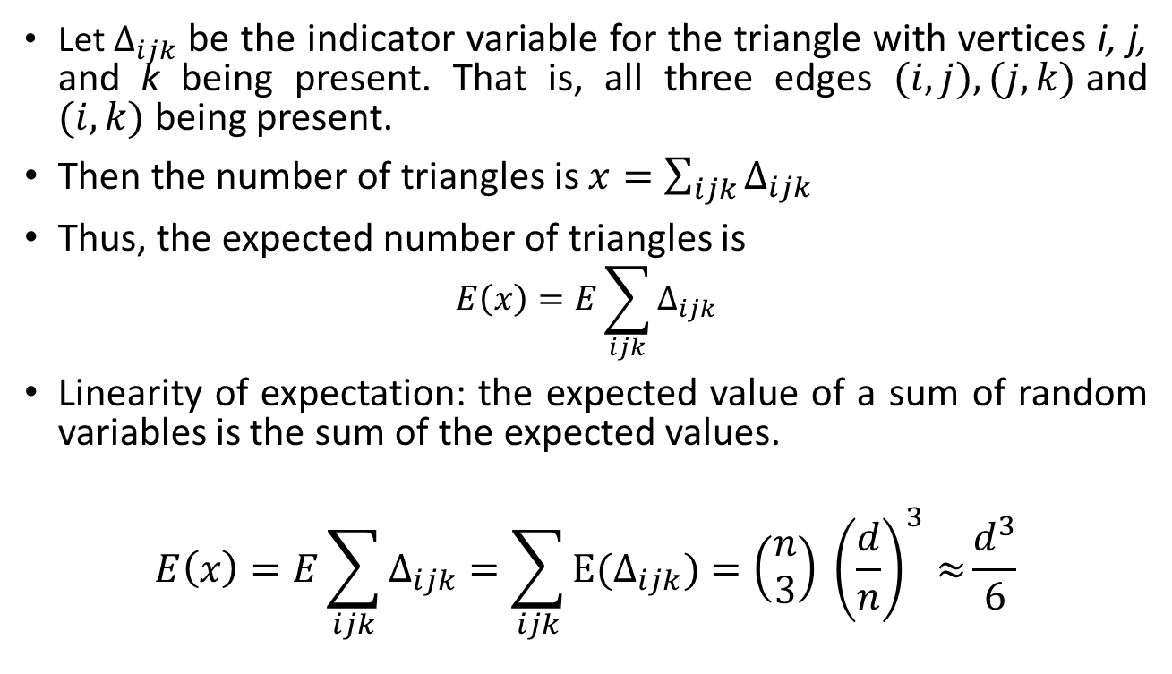

Existence of Triangles in $G(n, \frac{d}{n})$
Let $Δ_{ijk}$ be the indicator variable for the triangle with vertices i, j, and k being present. That is, all three edges $(i, j), (j, k)$and $(i, k)$being present.
Then the number of triangles is $x=\sum_{ijk}{Δ_{ijk}}$
Thus, the expected number of triangles is
$$E\left(x\right)=E\sum_{ijk}{Δ_{ijk}}$$
Linearity of expectation: the expected value of a sum of random variables is the sum of the expected values.
$$E\left(x\right)=E\sum_{ijk}{Δ_{ijk}}=\sum_{ijk}{{E(Δ}_{ijk})=\left(\begin{matrix}n \\ 3\end{matrix}\right) {\left(\frac{d}{n}\right)}^{3}≈}\frac{d^{3}}{6}$$

Slide 55
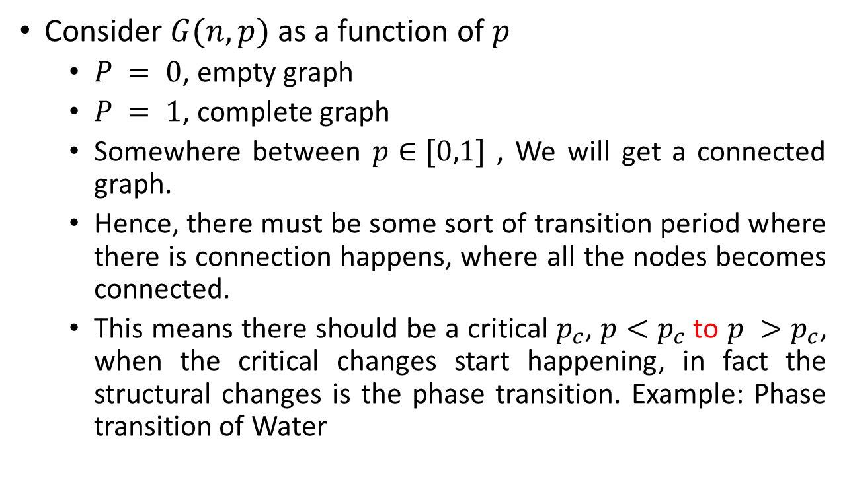
Phase Transitions
Consider $G(n, p)$as a function of $p$
$P = 0$, empty graph
$P = 1$, complete graph
Somewhere between $p∈[0,1]$ , We will get a connected graph.
Hence, there must be some sort of transition period where there is connection happens, where all the nodes becomes connected.
This means there should be a critical $p_{c}$, $p<p_{c}$to $p >p_{c}$, when the critical changes start happening, in fact the structural changes is the phase transition. Example: Phase transition of Water

Slide 56
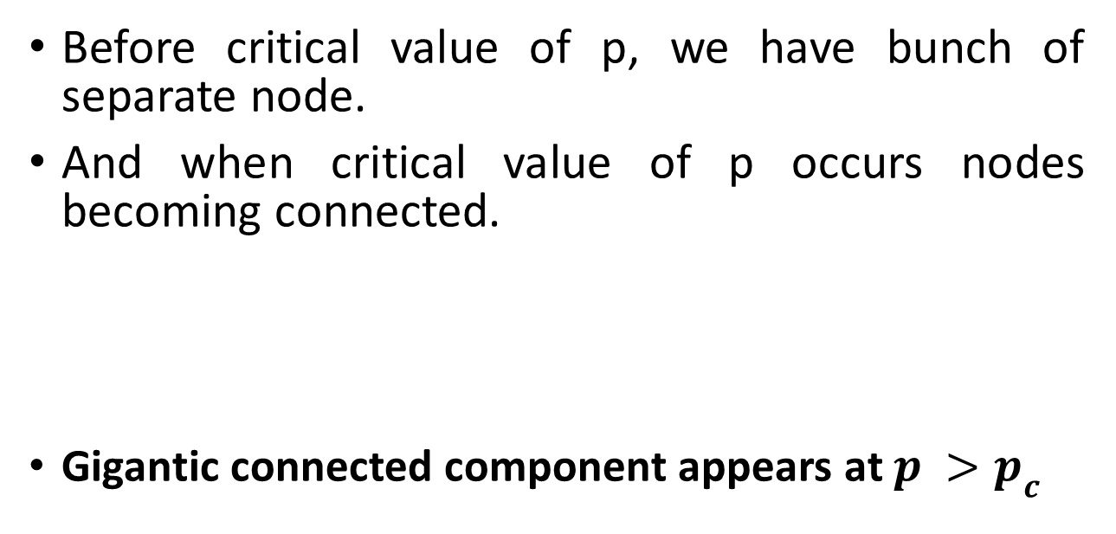
Phase Transitions
Before critical value of p, we have bunch of separate node.
And when critical value of p occurs nodes becoming connected.
Gigantic connected component appears at $p >p_{c}$

Slide 57
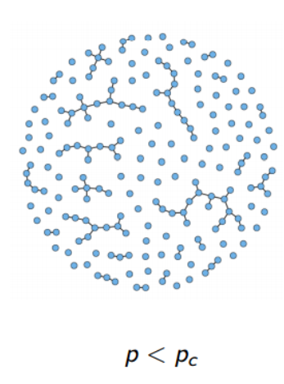
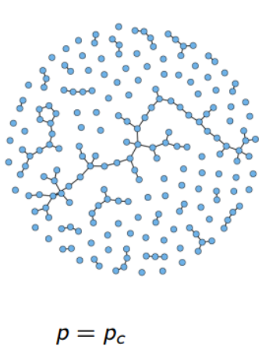
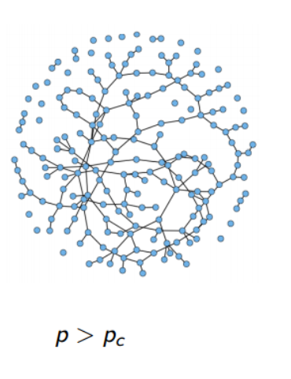
Phase Transitions

Slide 58
Phase Transitions
p = 0.0 ; k = 0
p = 0.09 ; k = 1
p = 0.045 ; k = 0.5
Let’s look at…
Size of the largest connected cluster
p = 1.0 ; k ≈ N
Diameter (maximum path length between nodes) of the largest cluster
Average path length between nodes (if a path exists)

Slide 59
Phase Transitions
p = 0.0 ; k = 0
p = 0.045 ; k = 0.5
p = 0.09 ; k = 1
p = 1.0 ; k ≈ N
Size of largest component
1
5
11
12
Diameter of largest component
0
4
7
1
Average path length between (connected) nodes
0.0
2.0
4.2
1.0

Slide 60

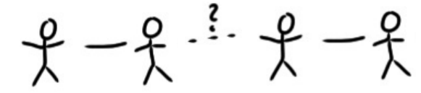
Giant Components: Intuitive Idea
If your friend starts getting connected to someone other than yourself, then you are more likely to belong to a larger component.
The emergence of the giant component sets in when each node has degree of at least 1. Any new edge added to the network is more likely to merge two disconnected groups. Hence, the giant component is very likely to emerge if the average degree of a node exceeds 1.
As the network evolves, there cannot be two giant components. The addition of new edges is likely to merge two giant components and evolve them as one single giant component.

Slide 61
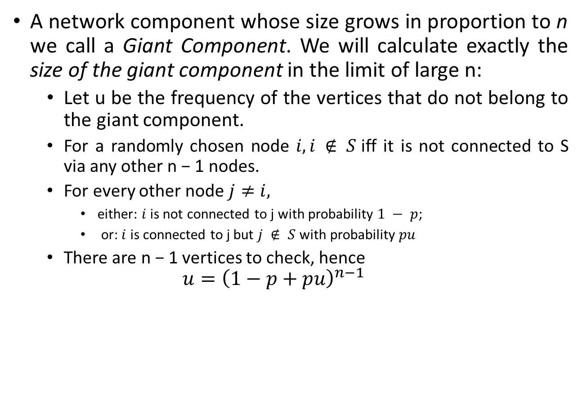
Giant Components: Intuitive Idea
A network component whose size grows in proportion to n we call a Giant Component. We will calculate exactly the size of the giant component in the limit of large n:
Let u be the frequency of the vertices that do not belong to the giant component.
For a randomly chosen node $i, i ∉ S$iff it is not connected to S via any other n − 1 nodes.
For every other node $j≠i,$
either: $i$ is not connected to j with probability $1 − p$;
or: $i$ is connected to j but $j ∉ S$with probability $pu$
There are n − 1 vertices to check, hence
$$u={\left(1−p+pu\right)}^{n−1}$$

Slide 62
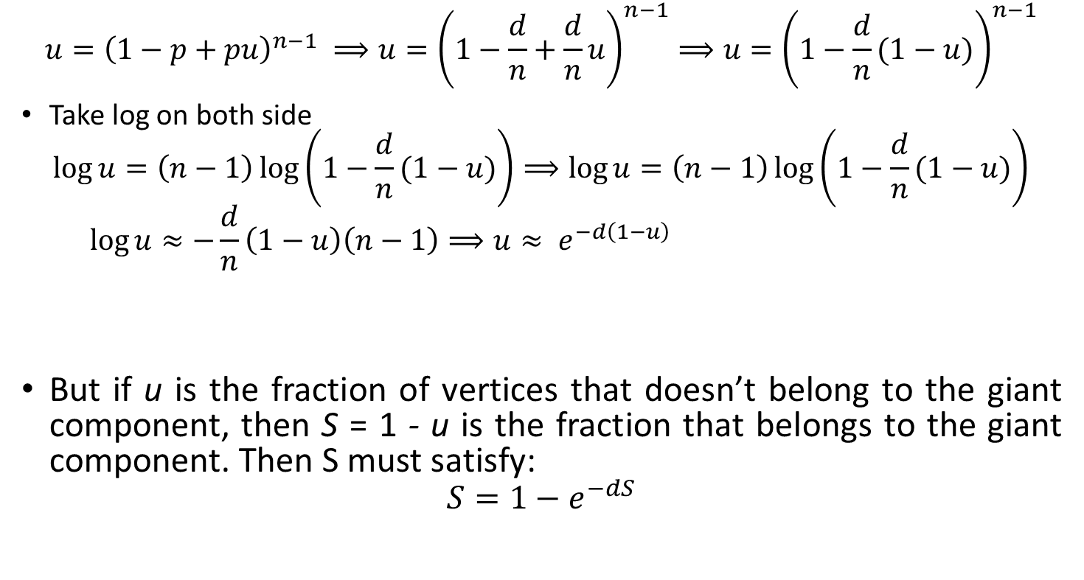
Giant Components: Intuitive Idea
$$u={\left(1−p+pu\right)}^{n−1} ⟹u={\left(1−\frac{d}{n}+\frac{d}{n}u\right)}^{n−1}⟹u={\left(1−\frac{d}{n}(1−u)\right)}^{n−1}$$
Take log on both side
$$\log{u}=\left(n−1\right)\log\left(1−\frac{d}{n}(1−u)\right)⟹\log{u}=\left(n−1\right)\log\left(1−\frac{d}{n}(1−u)\right)$$
$$\log{u}≈−\frac{d}{n}\left(1−u\right)\left(n−1\right)⟹u≈ e^{−d\left(1−u\right)}$$
But if u is the fraction of vertices that doesn’t belong to the giant component, then S = 1 - u is the fraction that belongs to the giant component. Then S must satisfy:
$$S=1−e^{−dS}$$

Slide 63
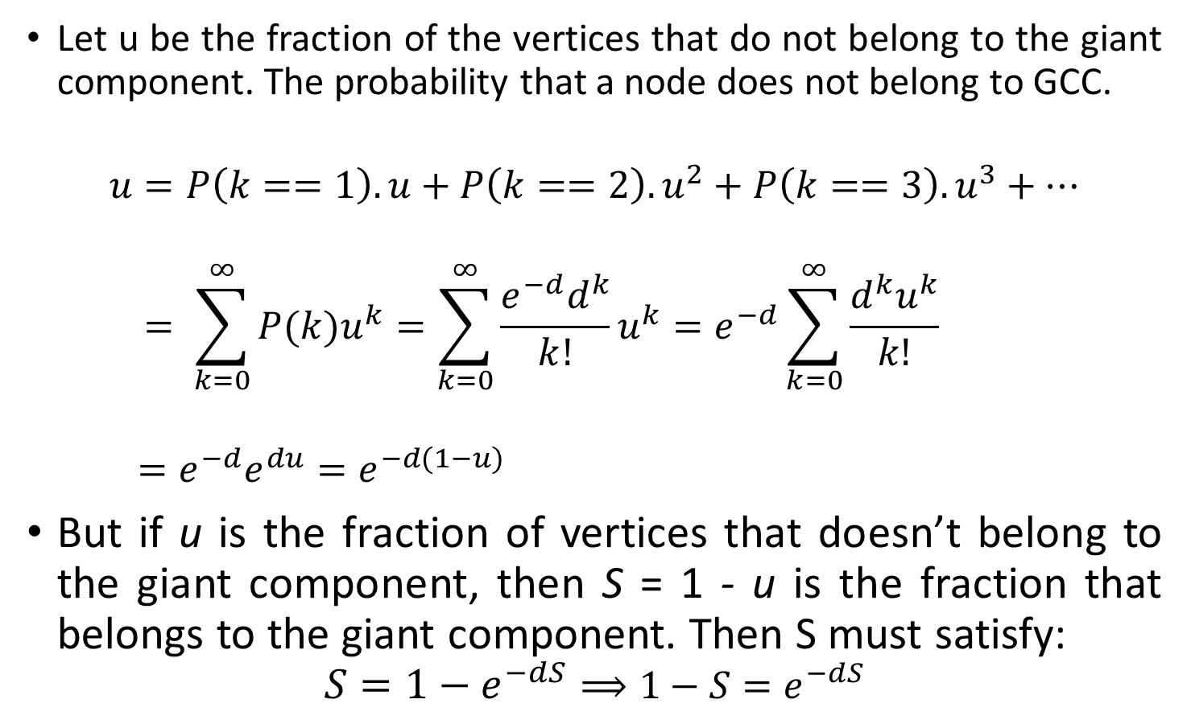
Giant Components: Intuitive Idea
Let u be the fraction of the vertices that do not belong to the giant component. The probability that a node does not belong to GCC.
$$u=P\left(k==1\right).u+P\left(k==2\right).u^{2}+P\left(k==3\right).u^{3}+…$$
$$= \sum_{k=0}^{∞}{P(k)u^{k}}=\sum_{k=0}^{∞}{\frac{e^{−d}d^{k}}{k!}u^{k}}=e^{−d}\sum_{k=0}^{∞}{\frac{{d^{k}u}^{k}}{k!}}$$
$$=e^{−d}e^{du}=e^{−d(1−u)}$$
But if u is the fraction of vertices that doesn’t belong to the giant component, then S = 1 - u is the fraction that belongs to the giant component. Then S must satisfy:
$$S=1−e^{−dS}⟹1−S=e^{−dS}$$

Slide 64
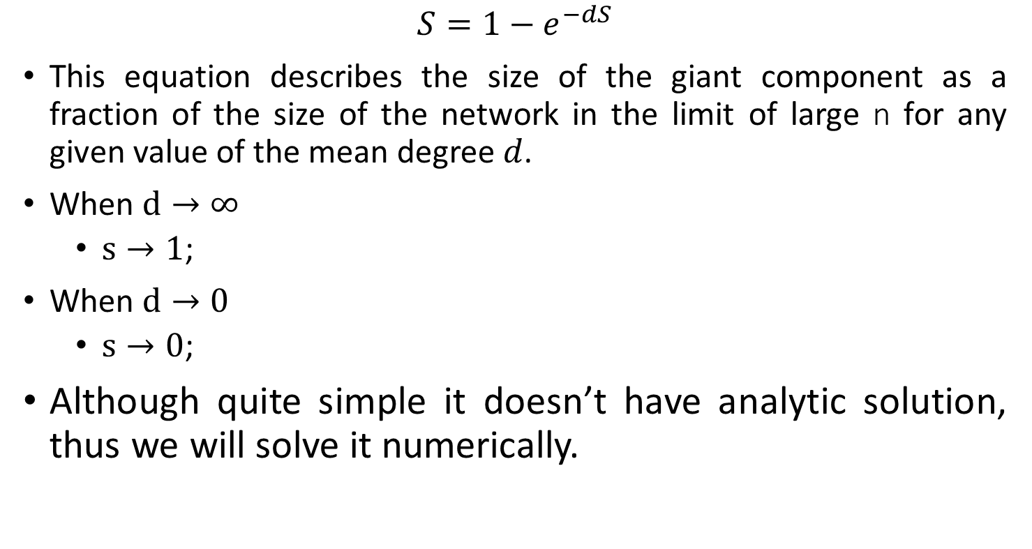
Giant Components: Intuitive Idea
$$S=1−e^{−dS}$$
This equation describes the size of the giant component as a fraction of the size of the network in the limit of large n for any given value of the mean degree $d$.
When $d→∞$
$s→1$;
When $d→0$
$s→0$;
Although quite simple it doesn’t have analytic solution, thus we will solve it numerically.

Slide 65
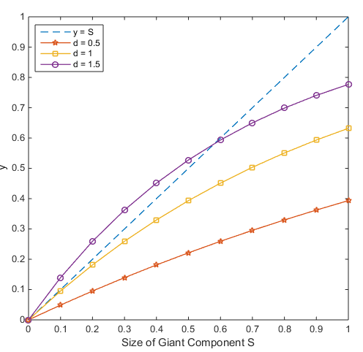
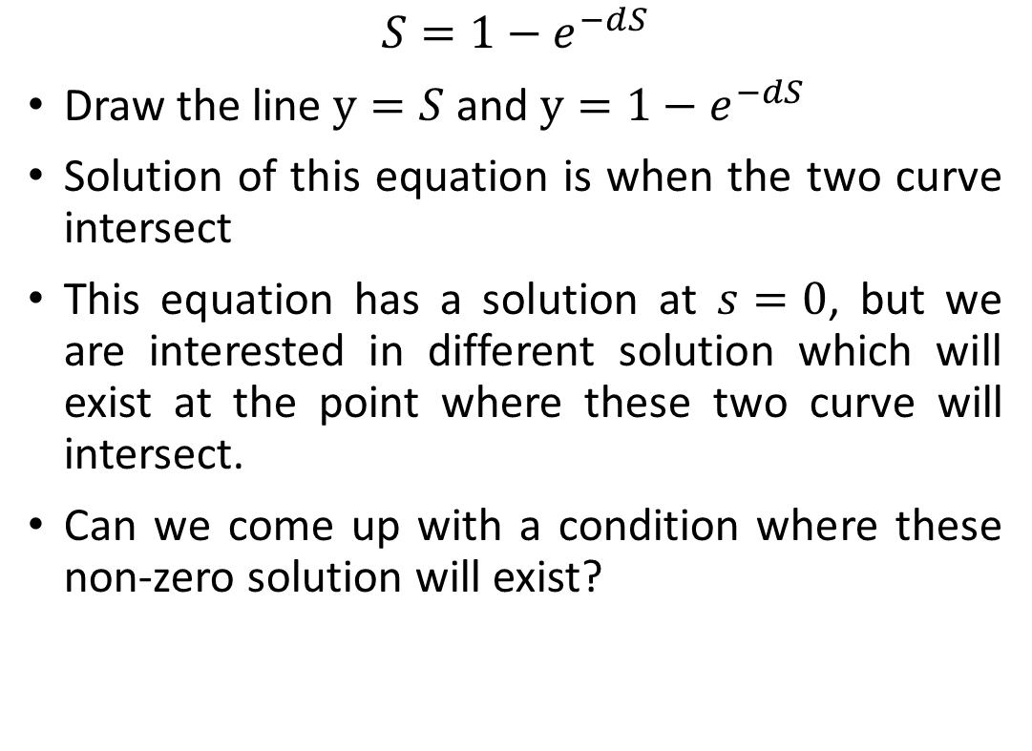
Giant Components: Intuitive Idea
$$S=1−e^{−dS}$$
Draw the line $y=S$ and $y=1−e^{−dS}$
Solution of this equation is when the two curve intersect
This equation has a solution at $s=0$, but we are interested in different solution which will exist at the point where these two curve will intersect.
Can we come up with a condition where these non-zero solution will exist?

Slide 66
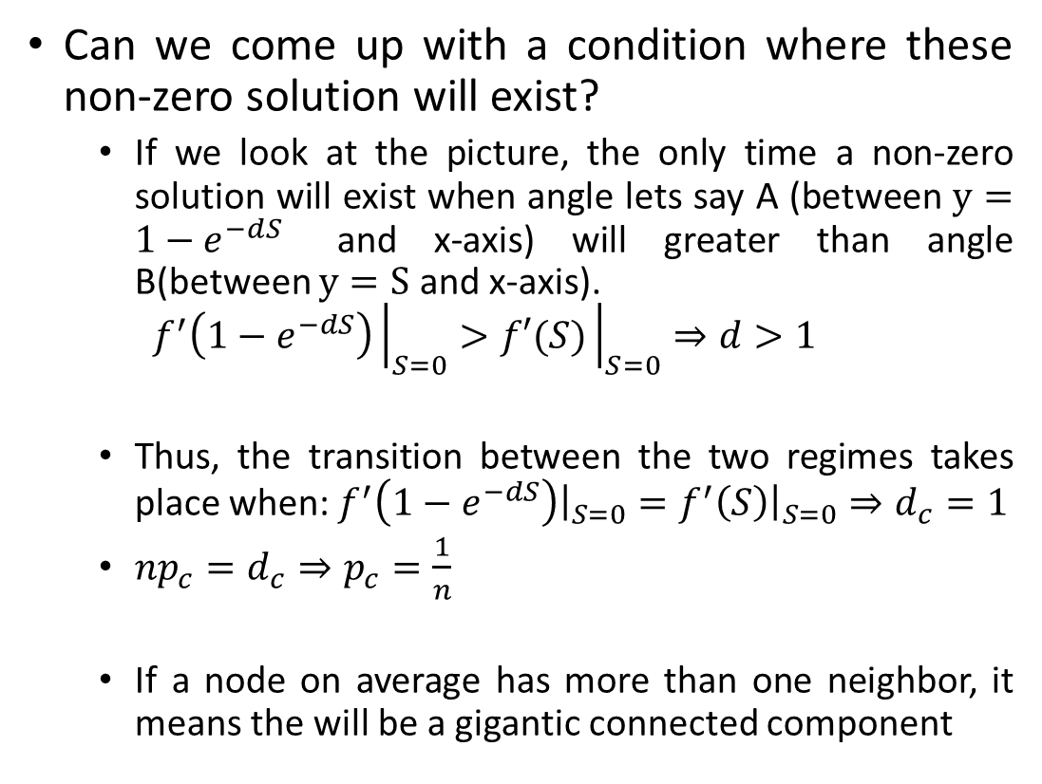
Giant Components: Intuitive Idea
Can we come up with a condition where these non-zero solution will exist?
If we look at the picture, the only time a non-zero solution will exist when angle lets say A (between $y=1−e^{−dS}$ and x-axis) will greater than angle B(between $y=S$ and x-axis).
$$f^{′}\left(1−e^{−dS}\right){\left.​\right|}_{S=0}>f′(S){\left.​\right|}_{S=0}⇒d>1$$
Thus, the transition between the two regimes takes place when: $f^{′}\left(1−e^{−dS}\right){\left.​\right|}_{S=0}=f^{′}\left(S\right){\left.​\right|}_{S=0}⇒d_{c}=1$
$np_{c}=d_{c}⇒p_{c}=\frac{1}{n}$
If a node on average has more than one neighbor, it means the will be a gigantic connected component
?

Slide 67
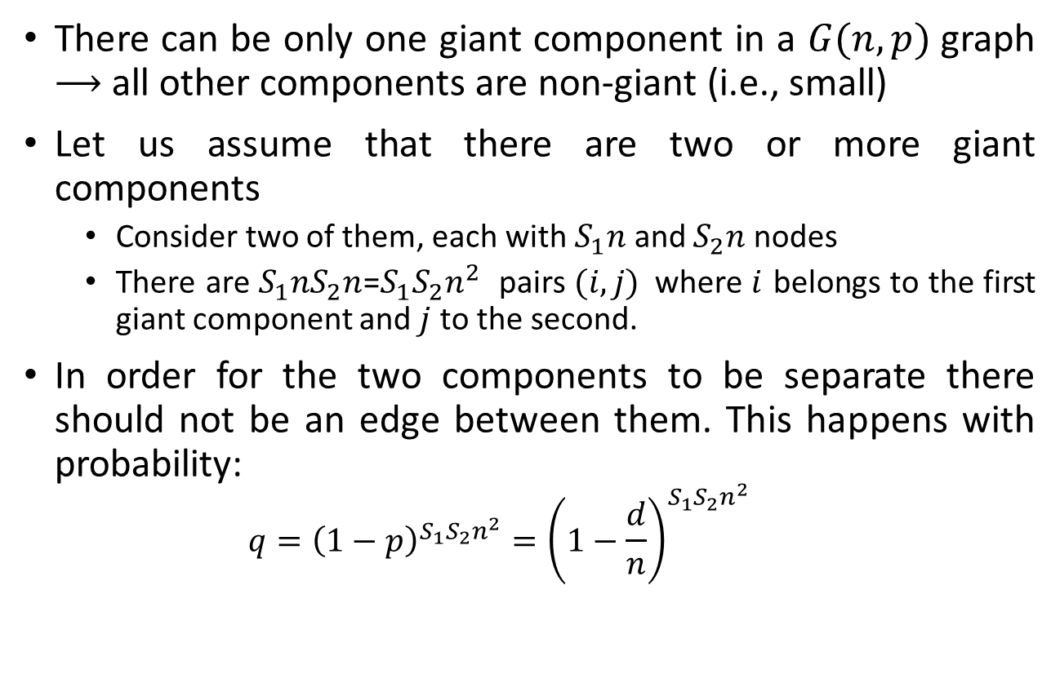
Giant Components: Intuitive Idea
There can be only one giant component in a $G(n,p)$graph $⟶$ all other components are non-giant (i.e., small)
Let us assume that there are two or more giant components
Consider two of them, each with $S_{1}n$ and $S_{2}n$ nodes
There are $S_{1}nS_{2}n$=${S_{1}S}_{2}n^{2}$ pairs $(i,j)$where $i$ belongs to the first giant component and $j$ to the second.
In order for the two components to be separate there should not be an edge between them. This happens with probability:
$$q={\left(1−p\right)}^{{S_{1}S}_{2}n^{2}}={\left(1−\frac{d}{n}\right)}^{{S_{1}S}_{2}n^{2}}$$

Slide 68
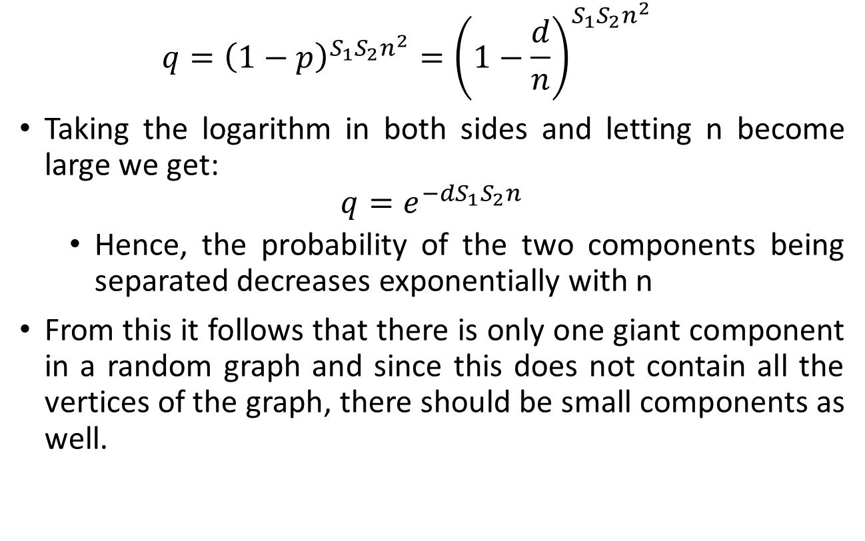
Giant Components: Intuitive Idea
$$q={\left(1−p\right)}^{{S_{1}S}_{2}n^{2}}={\left(1−\frac{d}{n}\right)}^{{S_{1}S}_{2}n^{2}}$$
Taking the logarithm in both sides and letting n become large we get:
$$q=e^{−dS_{1}S_{2}n}$$
Hence, the probability of the two components being separated decreases exponentially with n
From this it follows that there is only one giant component in a random graph and since this does not contain all the vertices of the graph, there should be small components as well.

Slide 69
What do you think?
I toss a coin 1000 times. The probability that I get 14 consecutive heads is
A
B
C
< 10%
≈ 50%
> 90%

Slide 70
Consecutive heads
Let N be the number of occurrences of 14 consecutive heads in 1000 coin flips.
N = I₁ + … + I₉₈₇
where I_{i} is an indicator r.v. for the event
“14 consecutive heads starting at position i”
E[I_{i} ] = P(I_{i} = 1) = 1/2¹⁴
E[N ] = 987 ⋅ 1/2¹⁴
= 987/16384
≈ 0.0602

Slide 71
Markov’s inequality
For every non-negative random variable X and every value a:
P(X ≥ a) ≤ E[X] / a.
E[N ] ≈ 0.0602
P[N ≥ 1] ≤ E[N ] / 1 ≤ 6%.

Slide 72
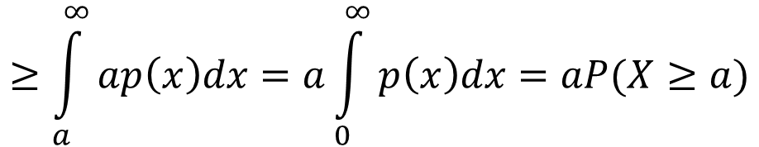
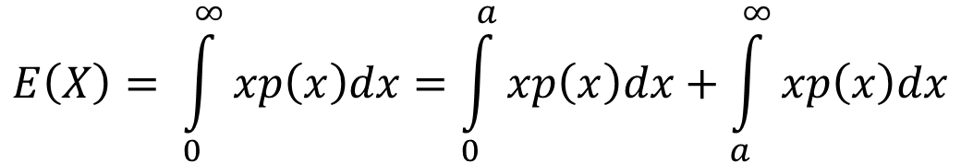
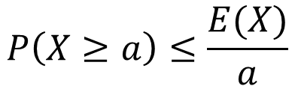
Proof of Markov’s inequality
For every non-negative random variable X: and every value a:
P(X ≥ a) ≤ E[X] / a.
$$E\left(X\right)= \int_{0}^{∞}{xp\left(x\right)dx}=\int_{0}^{a}{xp\left(x\right)dx}+\int_{a}^{∞}{xp\left(x\right)dx}$$
$$≥\int_{a}^{∞}{ap\left(x\right)dx}=a\int_{0}^{∞}{p\left(x\right)dx}=aP(X≥a)$$
$$P\left(X≥a\right)≤\frac{E(X)}{a}$$

Slide 73
Hats
1000 people throw their hats in the air. What is the probability at least 100 people get their hat back?
Solution
N = I₁ + … + I₁₀₀₀
where I_{i} is the indicator for the event that person i gets their hat. Then E[I_{i} ] = P(I_{i} = 1) = 1/n
E[N ] = n 1/n = 1
P[N ≥ 100] ≤ E[N ] / 100 = 1%.

Slide 74
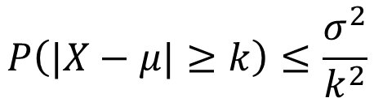
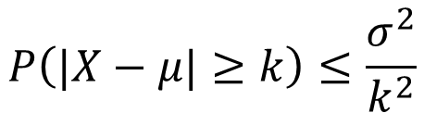
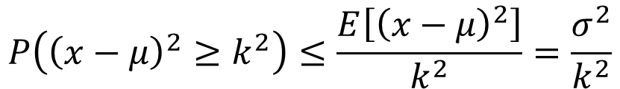
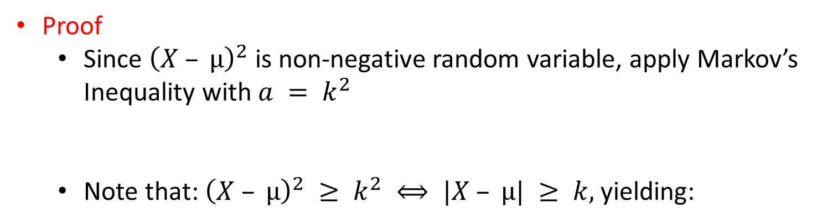
Chebyshev’s Inequality
What is the probability that the value of X is far from its expectation ?
Let X be a random variable with $E[X] = µ, Var(X) =σ^{2}$
$$P\left(|X−μ|≥k\right)≤\frac{σ^{2}}{k^{2}}$$
Proof
Since ${\left(X – µ\right)}^{2}$is non-negative random variable, apply Markov’s Inequality with $a = k^{2}$
Note that: ${\left(X – µ\right)}^{2} ≥ k^{2} ⟺ |X – µ| ≥ k,$yielding:
$$P\left({\left(x−μ\right)}^{2}≥k^{2}\right)≤\frac{E\left[{\left(x−μ\right)}^{2}\right]}{k^{2}}=\frac{σ^{2}}{k^{2}}$$
$$P\left(|X−μ|≥k\right)≤\frac{σ^{2}}{k^{2}}$$

Slide 75
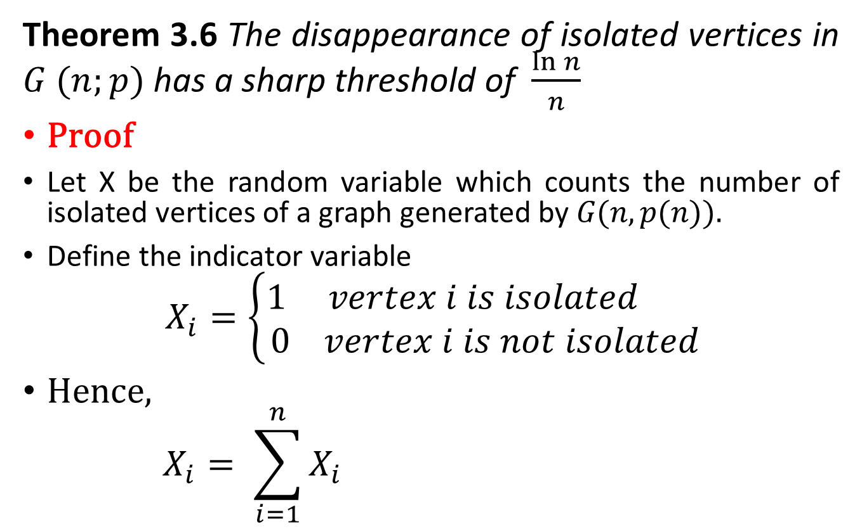
Disappearance of Isolated Vertices
Theorem 3.6 The disappearance of isolated vertices in $G (n;p)$ has a sharp threshold of $\frac{\ln{n}}{n}$
Proof
Let X be the random variable which counts the number of isolated vertices of a graph generated by $G(n, p(n)).$
Define the indicator variable
$$X_{i}=\left\{\begin{aligned}1 vertex i is isolated \\ 0 vertex i is not isolated\end{aligned}\right.$$
Hence,
$$X_{i}= \sum_{i=1}^{n}{X_{i}}$$

Slide 76
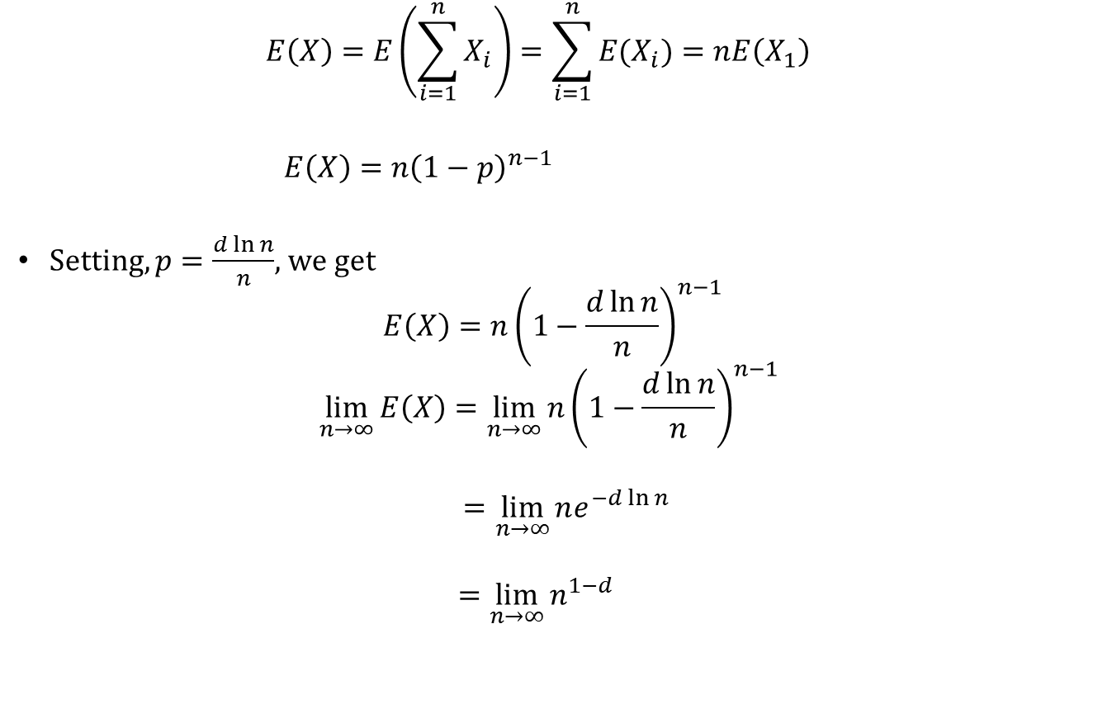
Disappearance of Isolated Vertices
$$E\left(X\right)=E\left(\sum_{i=1}^{n}{X_{i}}\right)=\sum_{i=1}^{n}{E(X_{i})}=nE\left(X_{1}\right)$$
$E\left(X\right)=n{\left(1−p\right)}^{n−1}$
Setting, $p=\frac{d\ln{n}}{n}$, we get
$$E\left(X\right)=n{\left(1−\frac{d\ln{n}}{n}\right)}^{n−1}$$
$$\lim_{n→∞}{E\left(X\right)}=\lim_{n→∞}{n{\left(1−\frac{d\ln{n}}{n}\right)}^{n−1}}$$
$$=\lim_{n→∞}{ne^{−d\ln{n}}}$$
$$=\lim_{n→∞}{n^{1−d}}$$

Slide 77
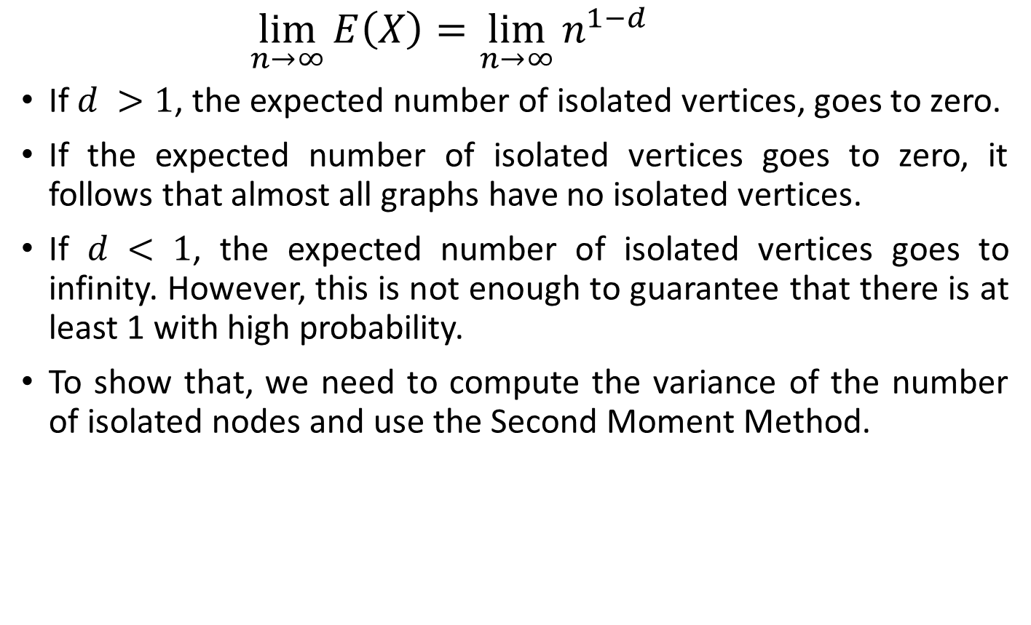
Disappearance of Isolated Vertices
$$\lim_{n→∞}{E\left(X\right)}=\lim_{n→∞}{n^{1−d}}$$
If $d >1$, the expected number of isolated vertices, goes to zero.
If the expected number of isolated vertices goes to zero, it follows that almost all graphs have no isolated vertices.
If $d < 1$, the expected number of isolated vertices goes to infinity. However, this is not enough to guarantee that there is at least 1 with high probability.
To show that, we need to compute the variance of the number of isolated nodes and use the Second Moment Method.

Slide 78
Disappearance of Isolated Vertices
$$\lim_{n→∞}{E\left(X\right)}=\lim_{n→∞}{n^{1−d}}$$
If $d >1$, the expected number of isolated vertices, goes to zero.
If the expected number of isolated vertices goes to zero, it follows that almost all graphs have no isolated vertices.
If $d < 1$, the expected number of isolated vertices goes to infinity. However, this is not enough to guarantee that there is at least 1 with high probability.
To show that, we need to compute the variance of the number of isolated nodes and use the Second Moment Method.

Slide 79

Disappearance of Isolated Vertices
Let X be a non-negative random variable with variance $var\left(X\right)$.
$P(X=0)=P [E(X)−X=E(X)]≤P [|X−E(X)|≥E(X)].$
Using Chebshev’s inequality on $P(|X−E(X)|≥E(X))$, we get
$P\left(\left|X−E\left(X\right)\right|≥E\left(X\right)\right)≤\frac{var\left(X\right)}{E^{2}(X)}$
Hence, $P(X=0) ≤\frac{var\left(X\right)}{E^{2}(X)}$
If $\frac{var\left(X\right)}{E^{2}(X)}$ → 0, then P(X = 0) → 0.
Now our goal is to show $\lim_{n→∞}{\frac{var\left(X\right)}{E^{2}(X)}}→0$

Slide 80

Disappearance of Isolated Vertices
The probability that two distinct nodes $u$ and $v$ are isolated is given by
The probability that the edge between them is absent and also that all $n − 2$possible edges from each of them to the remaining nodes is absent.
In total, it requires $2n − 3$edges to be absent.
$${E\left[X_{u}X_{v}\right]=\left(1−p\right)}^{2n−3}$$
$$cov\left(X_{u}X_{v}\right)=E\left[X_{u}X_{v}\right]−E\left[X_{u}\right]E\left[X_{v}\right]$$
$$={\left(1−p\right)}^{2n−3}−{\left(1−p\right)}^{2n−2}$$
$$={p\left(1−p\right)}^{2n−3}$$

Slide 81

Disappearance of Isolated Vertices
$$cov\left(X_{u}X_{v}\right)=E\left[X_{u}X_{v}\right]−E\left[X_{u}\right]E\left[X_{v}\right]$$
$$={\left(1−p\right)}^{2n−3}−{\left(1−p\right)}^{2n−2}$$
$$={p\left(1−p\right)}^{2n−3}$$
On the other hand, if u = v, then $X_{u}X_{v}=X_{u}^{2}=X_{u}$, and so
$$var\left(X_{u}\right)=E\left[X_{u}^{2}\right]−{\left(E\left[X_{u}\right]\right)}^{2}$$
$$={\left(1−p\right)}^{n−1}−{\left(1−p\right)}^{2n−2}$$
$$={\left(1−p\right)}^{n−1}(1−{\left(1−p\right)}^{n−1})$$
Since $X =\sum_{v∈V}{X_{v}}$, it follows that
$$var\left(X\right)=\sum_{\left(u,v\right)∈V}{cov\left(X_{u}X_{v}\right)}$$
$$=\sum_{\left(u\right)∈V}{var\left(X_{u}\right)} +\sum_{\left(u,v\right)∈V∧ u≠v}{cov\left(X_{u}X_{v}\right)}$$

Slide 82





Disappearance of Isolated Vertices
$$var(X)=\sum_{\left(u\right)∈V}{var\left(X_{u}\right)} +\sum_{\left(u,v\right)∈V∧ u≠v}{cov\left(X_{u}X_{v}\right)}$$
$$var\left(X\right)={{n\left(1−p\right)}^{n−1}\left(1−{\left(1−p\right)}^{n−1}\right)+ n(n−1)p\left(1−p\right)}^{2n−3}$$
$$There are n nodes$$
$$Var(X_{u})$$
$$total pairs, u≠v$$
$$cov\left(X_{u}X_{v}\right)$$

Slide 83

Disappearance of Isolated Vertices
$$var\left(X\right)={n{\left(1−p\right)}^{n−1}\left(1−{\left(1−p\right)}^{n−1}\right)+ n(n−1)p\left(1−p\right)}^{2n−3}$$
$$P\left(|X−E\left[X\right]|≥E\left[X\right]\right)≤\frac{var\left(X\right)}{{\left(E\left[X\right]\right)}^{2}}$$
$$\frac{var\left(X\right)}{{\left(E\left[X\right]\right)}^{2}}=\frac{{{n\left(1−p\right)}^{n−1}\left(1−{\left(1−p\right)}^{n−1}\right)+ n(n−1)p\left(1−p\right)}^{2n−3}}{n^{2}{\left(1−p\right)}^{2(n−1)}}$$
$$=\frac{1}{n{\left(1−p\right)}^{n−1}}−\frac{1}{n}+\left(1−\frac{1}{n}\right) \frac{p}{1−p}$$
For $p=\frac{d\ln{n}}{n}$ with d < 1, $\lim_{n→∞}{E\left(X\right)}=∞$

Slide 84

Disappearance of Isolated Vertices
$$\frac{var\left(X\right)}{{\left(E\left[X\right]\right)}^{2}}=\frac{1}{n{\left(1−p\right)}^{n−1}}−\frac{1}{n}+\left(1−\frac{1}{n}\right) \frac{p}{1−p}$$
For $p=$ $\frac{d\ln{n}}{n}$ with d < 1, $\lim_{n→∞}{E\left(X\right)}=∞$ and
$$\lim_{n→∞}{\frac{var\left(X\right)}{{\left(E\left[X\right]\right)}^{2}}}=\lim_{n→∞}{\frac{1}{n{\left(1−\frac{d\ln{n}}{n}\right)}^{n−1}}−\frac{1}{n}+\left(1−\frac{1}{n}\right) \frac{\frac{d\ln{n}}{n}}{1−\frac{d\ln{n}}{n}}}$$
$$=\lim_{n→∞}{\frac{1}{nn^{−d}}−\frac{1}{n}+\left(1−\frac{1}{n}\right) \frac{\frac{d\ln{n}}{n}}{1−\frac{d\ln{n}}{n}} }$$
$$=\lim_{n→∞}{\frac{1}{n^{1−d}}−\frac{1}{n}+\left(1−\frac{1}{n}\right) \frac{\frac{d\ln{n}}{n}}{1−\frac{d\ln{n}}{n}} }=0$$

Slide 85

Disappearance of Isolated Vertices
$$\lim_{n→∞}\frac{var\left(X\right)}{{\left(E\left[X\right]\right)}^{2}} =\lim_{n→∞}{\frac{1}{n^{2−d}}+\frac{1}{n^{2}}+\left(1−\frac{1}{n}\right) \frac{\frac{d\ln{n}}{n}}{1−\frac{d\ln{n}}{n}} }=0$$
Thus, $\frac{\ln{n}}{n}$ is a sharp threshold for the disappearance of isolated vertices.
For $p=\frac{d\ln{n}}{n}$, when $d > 1$there almost surely no isolated vertices, and when $d < 1$there almost surely are isolated vertices.

Slide 86

Diameter of a Random Graph
Consider a random network with average degree $d$.
A node in this network has on average:
$d$ nodes at distance one (l=1).
$d^{2}$nodes at distance two (l=1).
$d^{3}$ nodes at distance three (l =3).
...￼ $d^{l}$ nodes at distance $l$.
To be precise, the expected number of nodes up to distance $l$ from our starting node is
$$n\left(l\right)=1+d+d^{2}+d^{3}+…+d^{l}=\frac{d^{l+1}−1}{d−1}$$
$n\left(l\right)$ must not exceed the total number of nodes, $n$, in the network.
Hence, $n\left(l_{max}\right)=n$

Slide 87

Diameter of a Random Graph
Hence, $n\left(l_{max}\right)=n$
$$\frac{d^{l_{max}+1}−1}{d−1}=n$$
Assuming that $d≫1$, we can neglect the (-1) term in the nominator and the denominator.
$$d^{l_{max}}=n$$
Take log on both side
$$l_{max}\ln{d}=\ln{n}⟺l_{max}=\frac{\ln{n}}{\ln{d}}$$

Slide 88

Clustering Coefficient
The degree of a node contains no information about the relationship between a node's neighbors. Do they all know each other, or are they perhaps isolated from each other?
The answer is provided by the local clustering coefficient $C_{i}$ , that measures the density of links in node $i’s$ immediate neighborhood.
$C_{i}=0$means that there are no links between i’s neighbors
$C_{i}=1$implies that each of the i’s neighbors link to each other

Slide 89
Clustering Coefficient
Clustering coefficient: the average proportion of neighbours of a vertex that are themselves neighbours
Node
4 Neighbours (N)
2 Connections among the Neighbours
6 possible connections among the Neighbours
(Nx(N-1)/2)
Clustering for the node = 2/6
Clustering coefficient: Average over all the nodes

Slide 90
Clustering Coefficient
Clustering coefficient: the average proportion of neighbours of a vertex that are themselves neighbours
C=0
C=0
C=0
C=1

Slide 91


Clustering Coefficient
Let $k_{i}$ be the degree of node i.
Max. expected number of possible links between the $k_{i}$ neighbors of node i are $k_{i}(k_{i}−1)/2$.
$$C_{i}=\frac{\text{number} \text{of} \text{links} \text{between} \text{neighbors} }{\text{max} \text{number} \text{of} \text{links} \text{between} \text{neighbors}}$$
If $p$ is the probability that any two nodes in a network are connected, then the expected number of links between the $k_{i}$ neighbors of node$i$is
$$E\left[L_{i}\right]=p^{k_{i}(k_{i}−1)/2}$$
Expected Local clustering coefficient of node i:
$$C_{i}=\frac{p∗k_{i}(k_{i}−1)/2}{k_{i}(k_{i}−1)/ 2}=p$$

Slide 92

Clustering Coefficient
$$C_{i}=\frac{p∗k_{i}(k_{i}−1)/2}{k_{i}(k_{i}−1)/ 2}=p$$
For fixed , the larger the network, the smaller is a node’s clustering coefficient. Consequently a node's local clustering coefficient $C_{i}$ is expected to decrease as 1/N.
The local clustering coefficient of a node is independent of the node’s degree.

Slide 93
Hamiltonian paths
Find a path visiting each node exactly one
Conditions of existence for Hamiltonian paths are not simple

Slide 94

Hamiltonian paths
Let $x$ be the number of Hamilton circuits in $G(n, p)$and let $p=\frac{d}{n}$for some constant $d$.
There are $\frac{1}{2}(n − 1)!$potential Hamilton circuits in a graph and each has probability ${\left(\frac{d}{n}\right)}^{n}$ of actually being a Hamilton circuit. Thus
$$E\left(x\right)=\frac{1}{2}(n − 1)!{\left(\frac{d}{n}\right)}^{n}≃{\left(\frac{n}{e}\right)}^{n}{\left(\frac{d}{n}\right)}^{n}$$
$${\left(\frac{d}{e}\right)}^{n}=\left\{\begin{aligned}0 d<e \\ ∞ d>e\end{aligned}\right.$$
This suggests that the threshold for Hamilton circuits occurs when d equals Euler’s constant e. This is not possible since the graph still has isolated vertices and is not even connected for
$$p=\frac{e}{n}$$

Slide 95

Hamiltonian paths
$$p=\frac{e}{n}$$
Thus, the second moment argument is indeed necessary.
The actual threshold for Hamilton circuits is $d =ω(\log{n}+ \log{\log{n}}$).
For any p(n) asymptotically greater than $\log{n}+ \log{\log{n}}$. $G(n, p)$will have a Hamilton circuit with probability one.

